Slide 1
Advanced Programming
Midterm Project - Maze Solver
Maral Mordad
Page From 24

Slide 2



BFS Algorithm
DFS Algorithm
Graphic (GUI)
Set all cells to not visited
All cells are surrounded by 4 walls
Choose a starting point
Move to a not visited neighbor
Remove the corresponding wall between the 2 cells
If all neighbors are visited in step 4 then move back to the previous cell
Do 4, 5, and 6 until all cells are visited
Main Algorithm
Code
Result
Page From 24

Slide 3
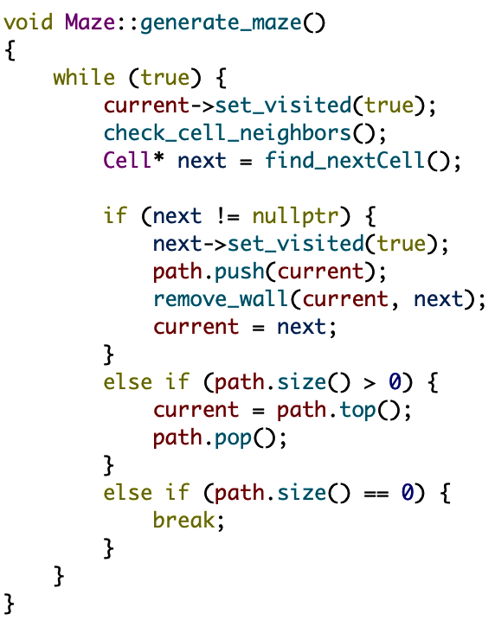
BFS Algorithm
DFS Algorithm
Graphic (GUI)
Main Algorithm
Code
Result
Page From 24

Slide 4
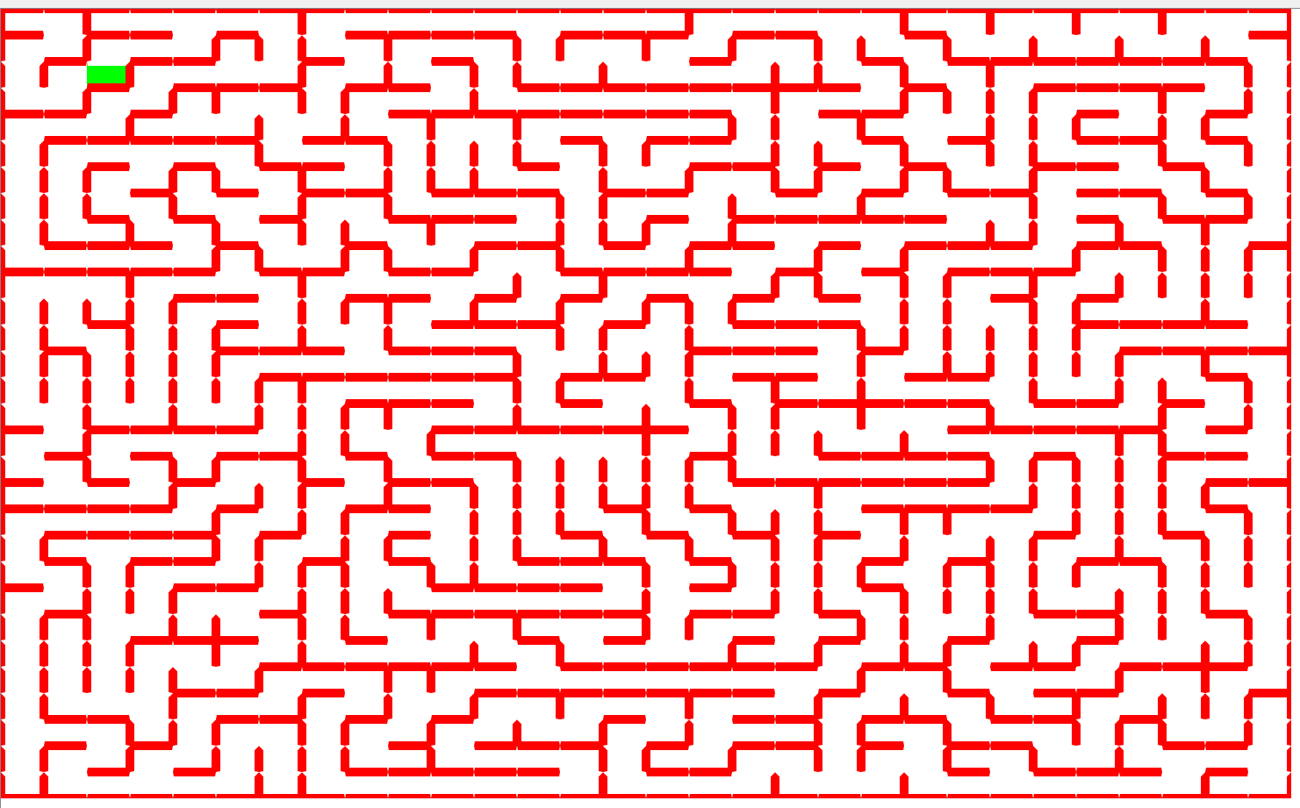
BFS Algorithm
DFS Algorithm
Graphic (GUI)
Main Algorithm
Code
Result
Page From 24

Slide 5


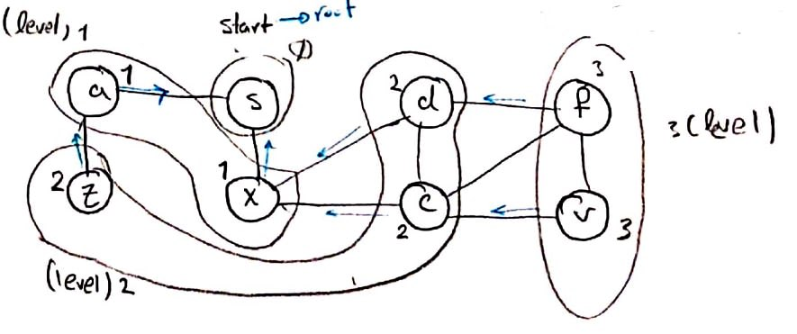
Maze Generation
DFS Algorithm
Graphic (GUI)
Example
Main Algorithm
Code
Result
Page From 24

Slide 6
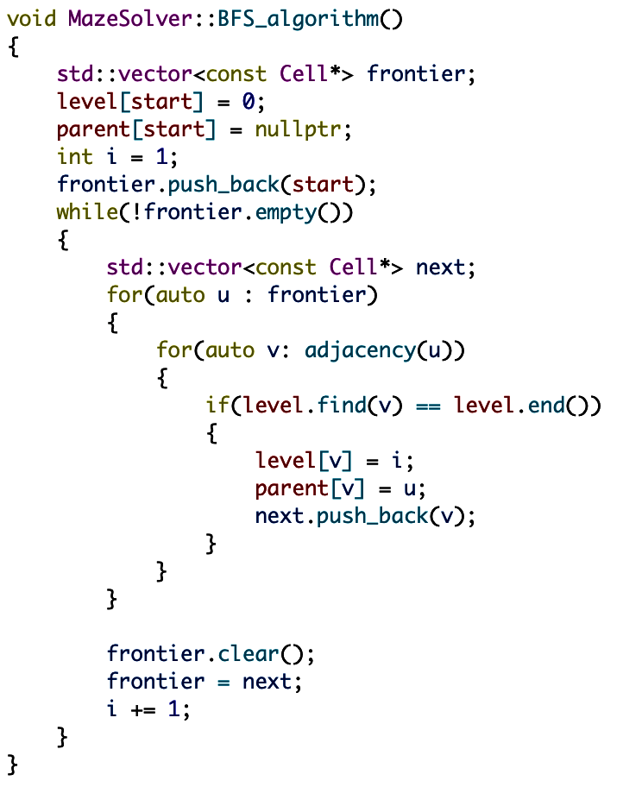
Maze Generation
DFS Algorithm
Graphic (GUI)
Main Algorithm
Code
Result
Page From 24

Slide 7
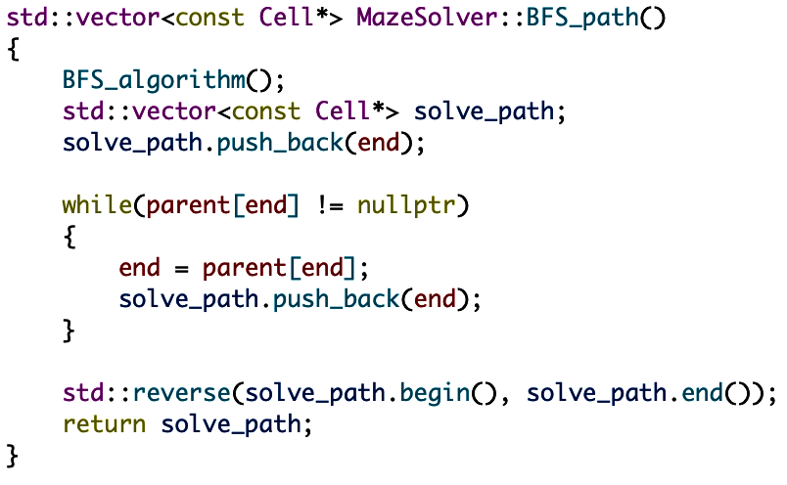
Maze Generation
DFS Algorithm
Graphic (GUI)
Main Algorithm
Code
Result
Page From 24

Slide 8
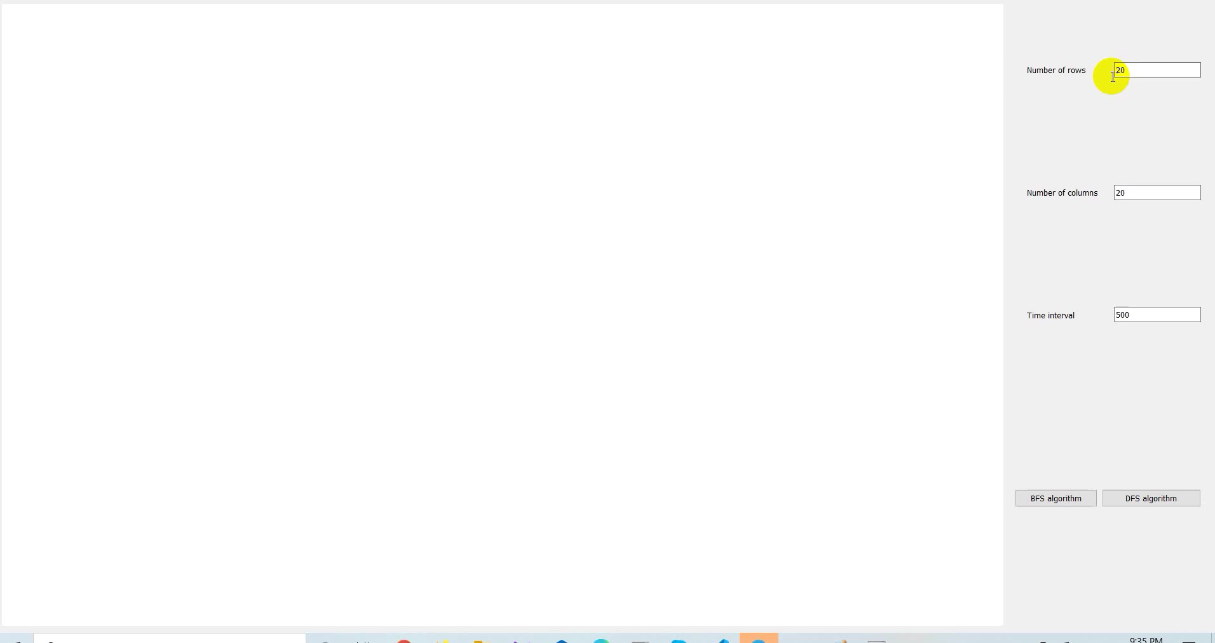
Maze Generation
DFS Algorithm
Graphic (GUI)
Main Algorithm
Code
Result
Page From 24

Slide 9


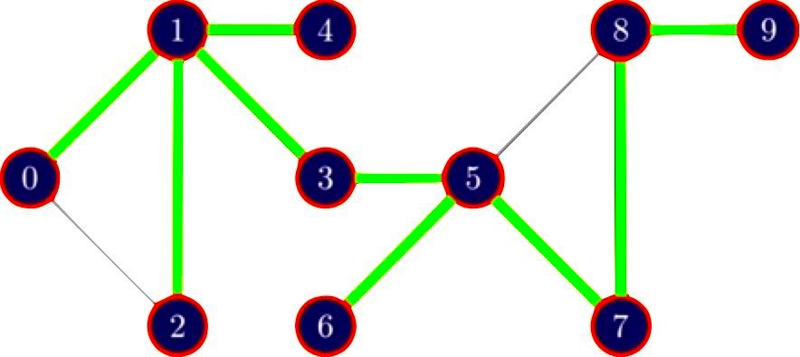
Maze Generation
BFS Algorithm
Graphic (GUI)
Example
Main Algorithm
Code
Result
Visit Order: 0 - 1 - 2 - 3 - 5 - 6 - 7 - 8 - 9 - 4
Page From 24

Slide 10
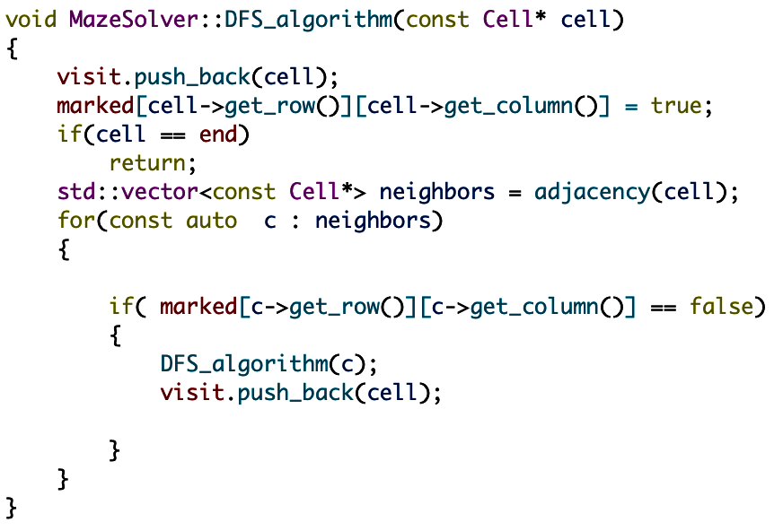
Maze Generation
BFS Algorithm
Graphic (GUI)
Main Algorithm
Code
Result
Page From 24

Slide 11
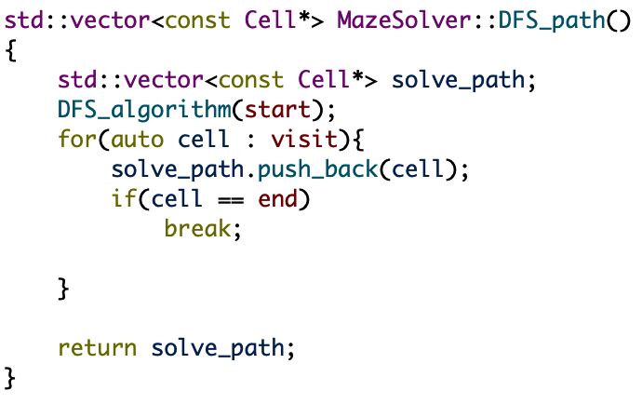
Maze Generation
BFS Algorithm
Graphic (GUI)
Main Algorithm
Code
Result
Page From 24

Slide 12
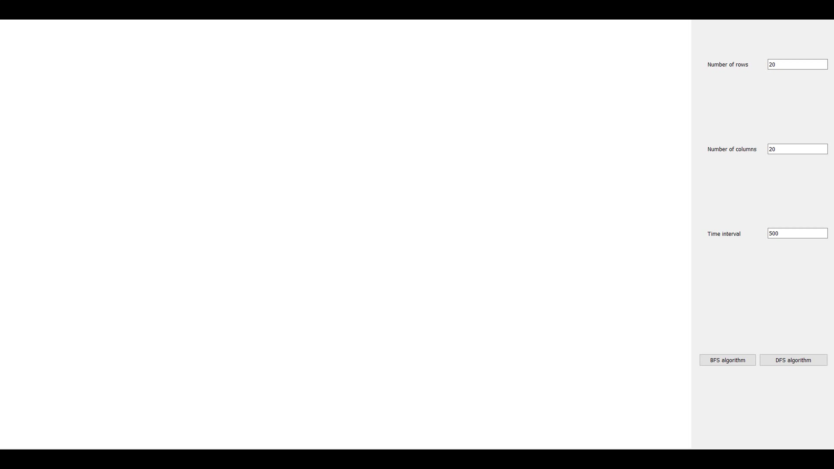
Maze Generation
BFS Algorithm
Graphic (GUI)
Main Algorithm
Code
Result
Page From 24

Slide 13


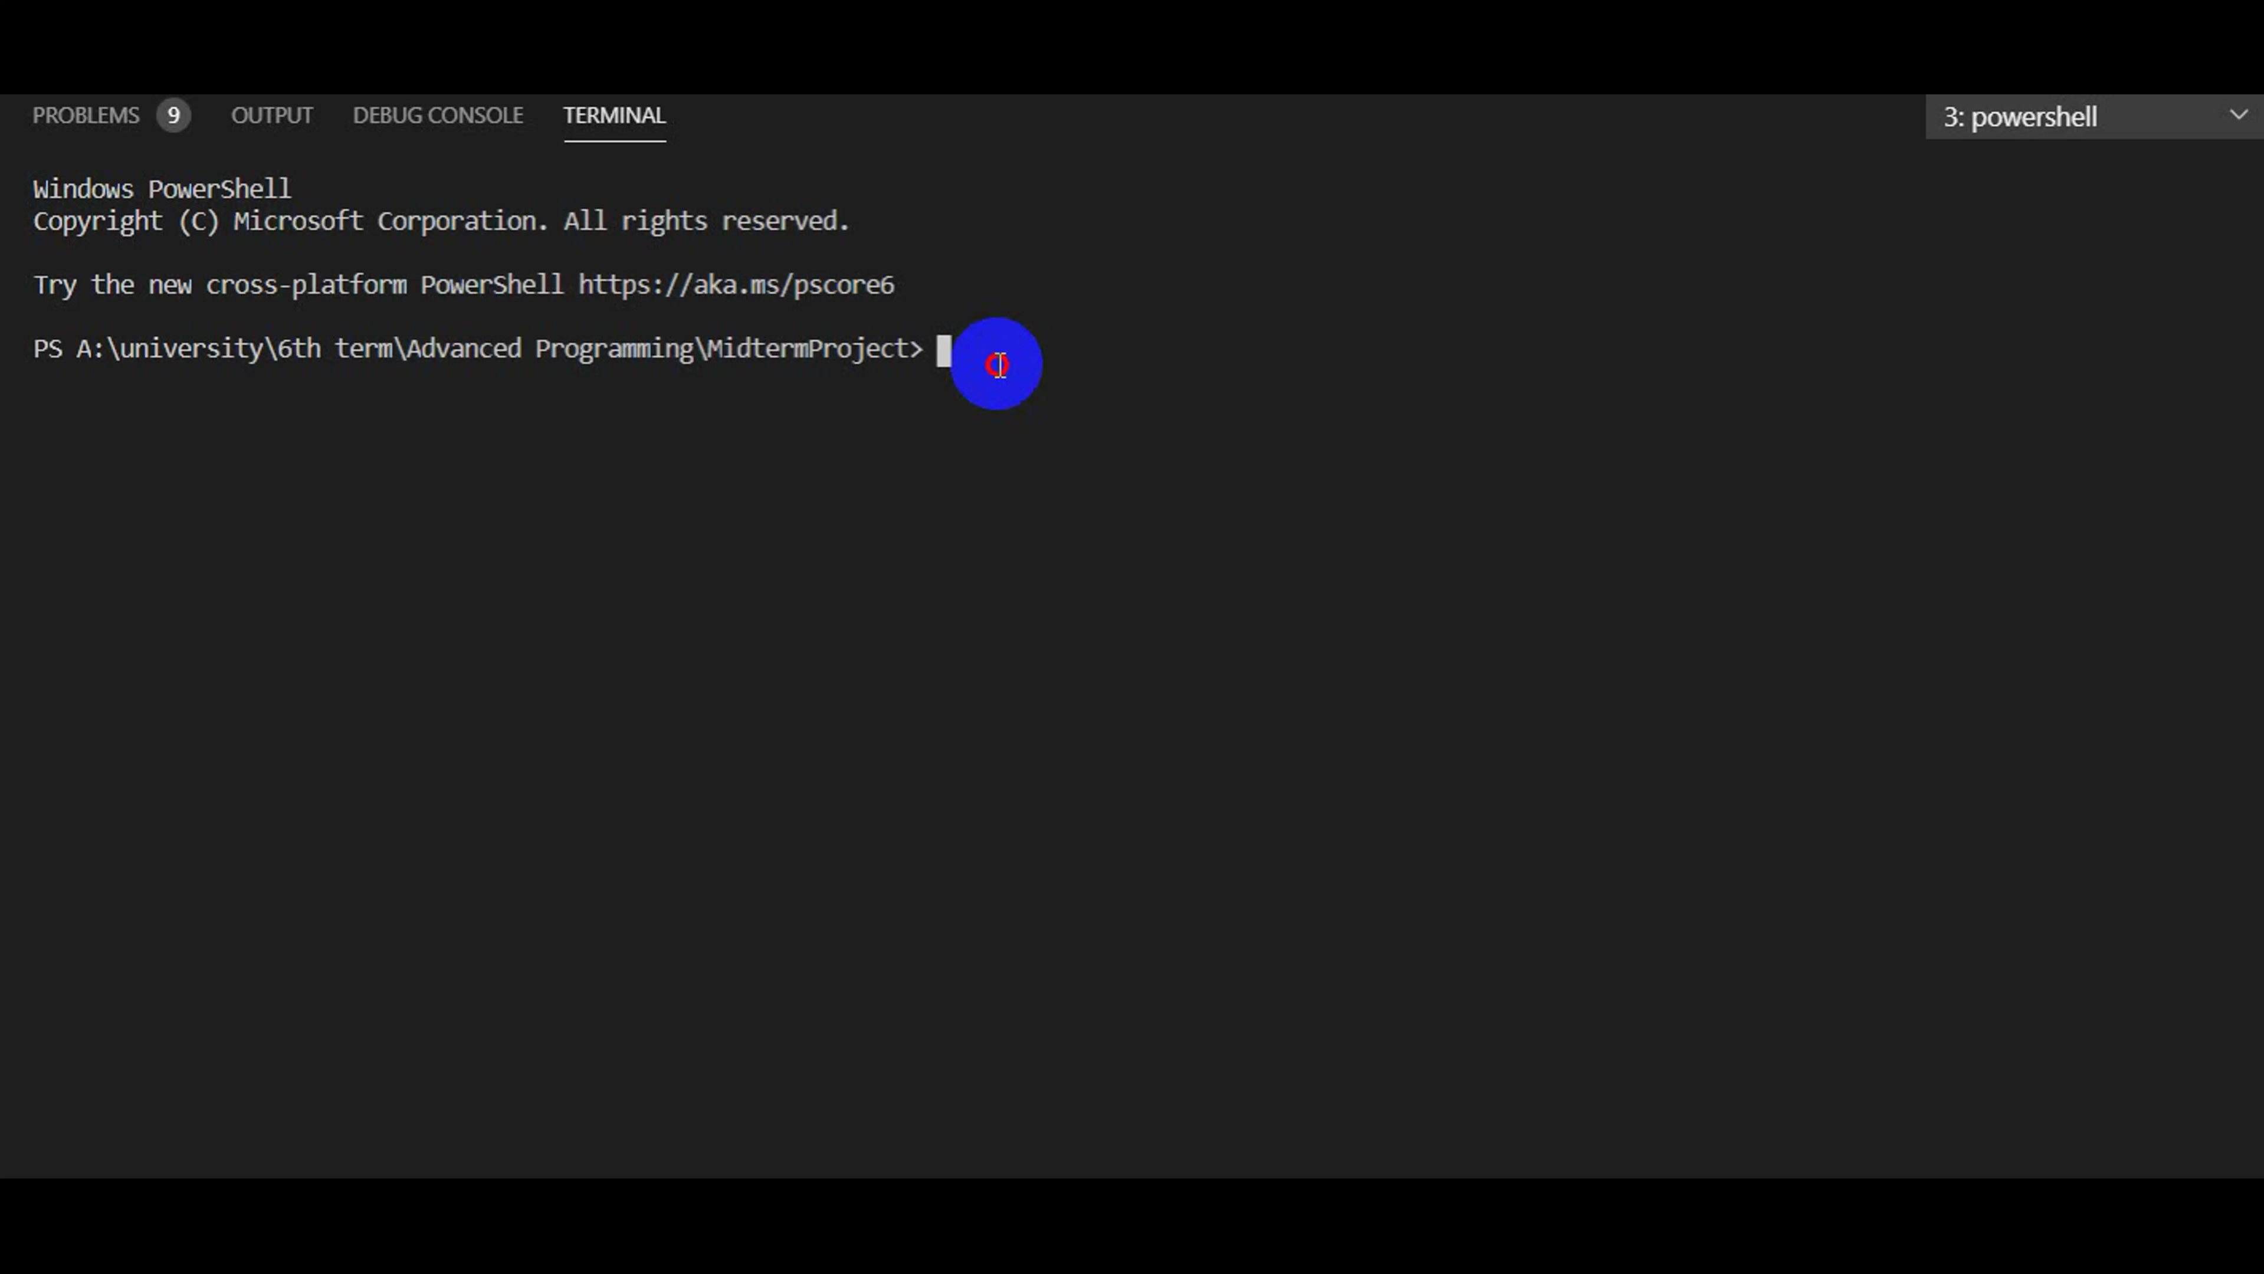
Maze Generation
BFS Algorithm
DFS Algorithm
ncurses
BFS
DFS
Qt
Page From 24

Slide 14
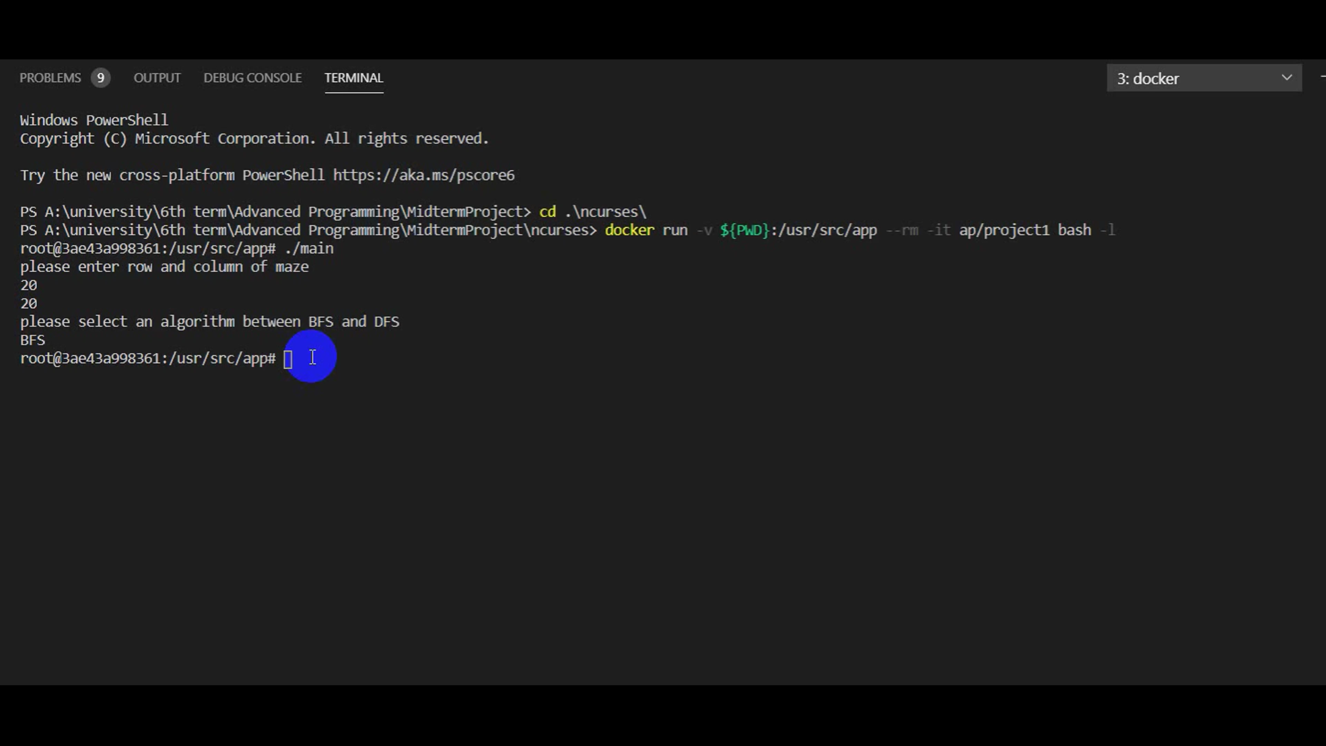
Maze Generation
BFS Algorithm
DFS Algorithm
ncurses
BFS
DFS
Qt
Page From 24

Slide 15
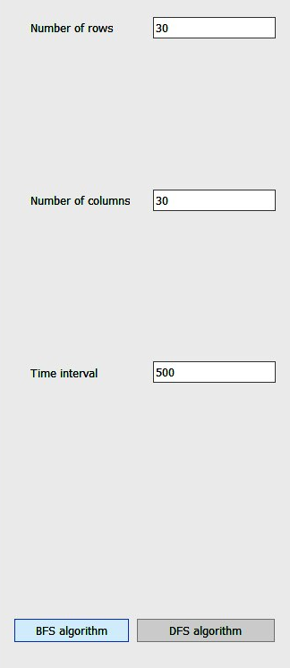
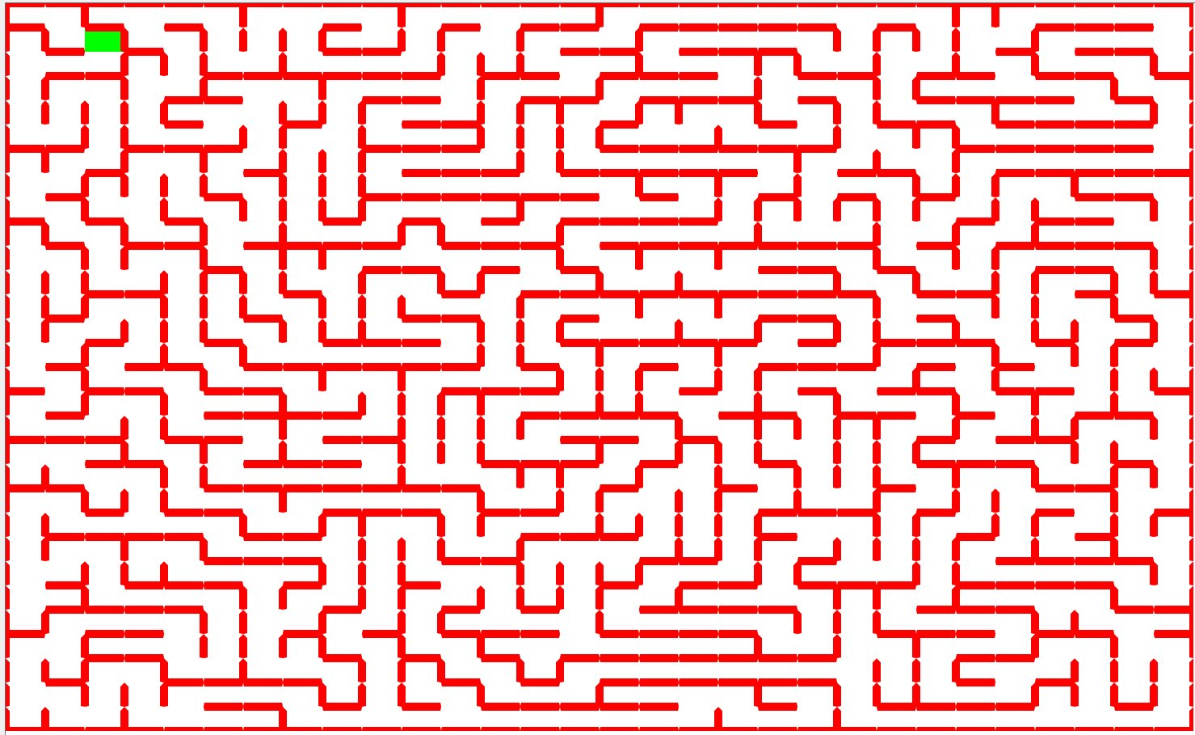
Maze Generation
BFS Algorithm
DFS Algorithm
ncurses
BFS
DFS
Qt
Page From 24

Slide 16

Maze Generation
BFS Algorithm
DFS Algorithm
Graphic (GUI)
Thank You

